Slide 1
Gles 기본

Slide 2
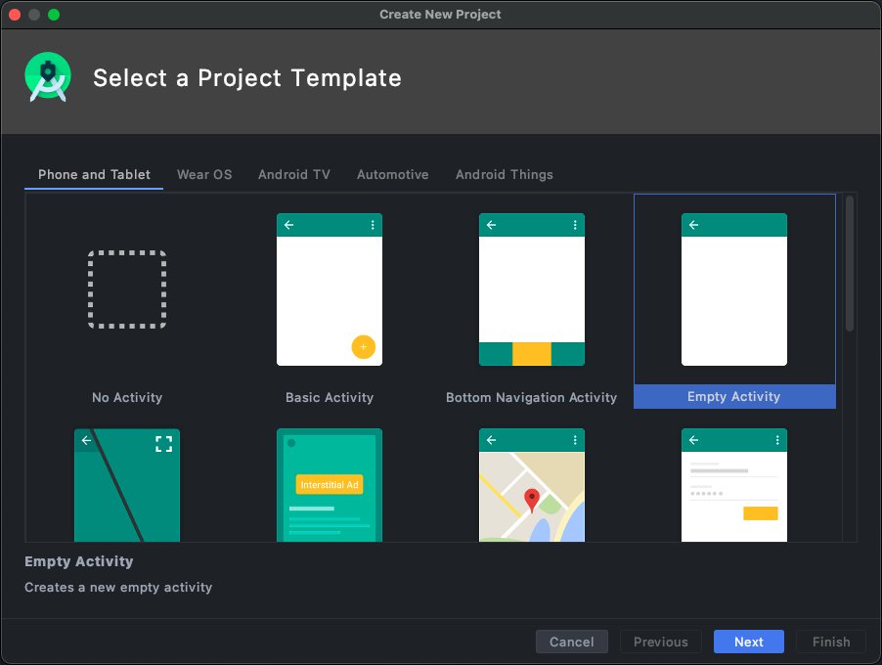
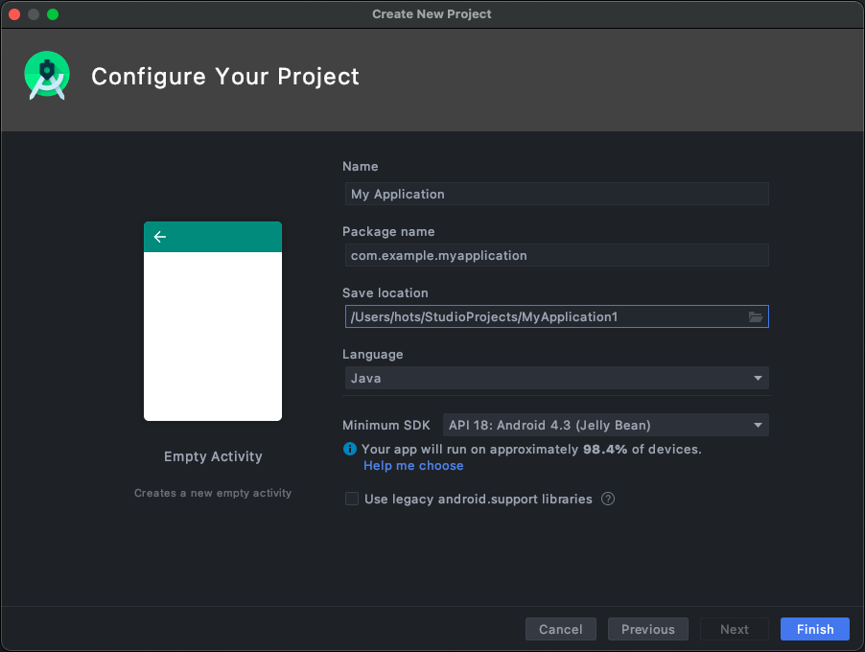
프로젝트 생성

Slide 3
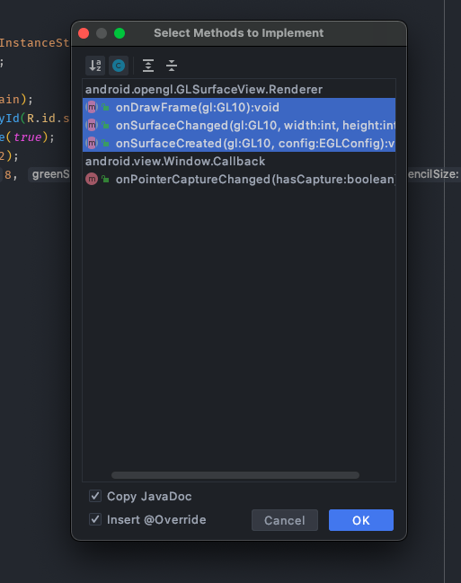
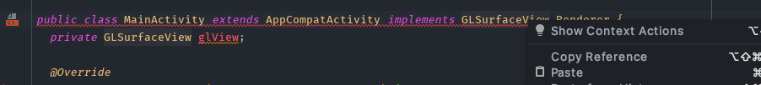
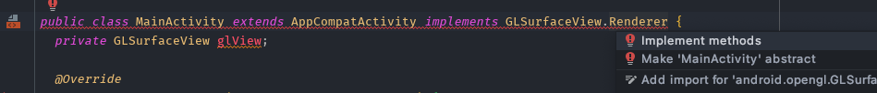
https://github.com/halfseal/gles2arcore/blob/master/1.gles_basic/basic_environment.zip 참고
AndroidManifest.xml
<uses-feature android:glEsVersion="0x00020000" android:required="true" />
protected void onCreate(Bundle savedInstanceState) { super.onCreate(savedInstanceState); setContentView(R.layout.activity_main); glView = (GLSurfaceView) findViewById(R.id.surfaceView); glView.setPreserveEGLContextOnPause(true); glView.setEGLContextClientVersion(2); glView.setEGLConfigChooser(8, 8, 8, 8, 16, 0); glView.setRenderer(this); }
<android.opengl.GLSurfaceView android:id="@+id/surfaceView" android:layout_width="match_parent" android:layout_height="match_parent" />

Slide 4
@Override public void onSurfaceCreated(GL10 gl, EGLConfig config) { GLES20.glClearColor(0.5f, 0.5f, 0.5f, 1.0f); } @Override public void onSurfaceChanged(GL10 gl, int width, int height) { gl.glViewport(0, 0, width, height); } @Override public void onDrawFrame(GL10 gl) { GLES20.glClear(GLES20.GL_COLOR_BUFFER_BIT | GLES20.GL_DEPTH_BUFFER_BIT); }
glClearColor : 초기 화면의 색상을 결정
glViewport : 화면의 크기를 결정
glClear : 프레임을 그리기 전 초기화 할 것을 세팅
자세하게 알고 싶으면 http://docs.gl 에서 함수 검색 후 es2 클릭

Slide 5
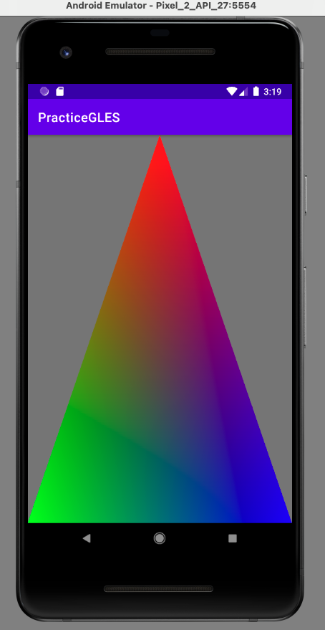
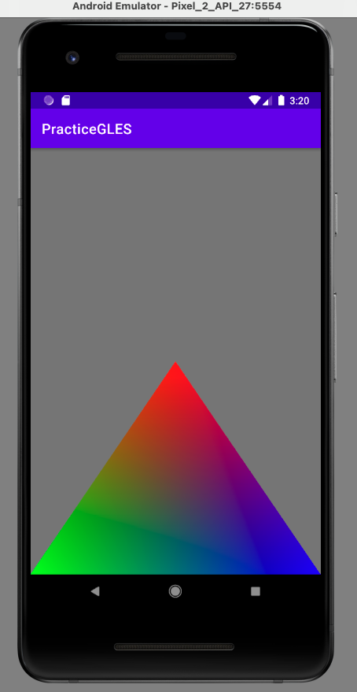
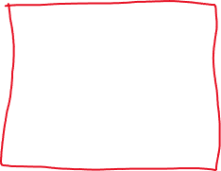
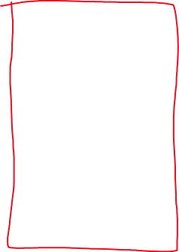
gl.glViewport(0, 0, width, height);
gl.glViewport(0, 0, width, height / 2);

Slide 6
갑자기 삼각형 만들기
MainActivity.java
private Triangle triangle;
@Override public void onSurfaceCreated(GL10 gl, EGLConfig config) { GLES20.glClearColor(0.5f, 0.5f, 0.5f, 1.0f);
triangle = new Triangle(); }
@Override public void onDrawFrame(GL10 gl) { GLES20.glClear(GLES20.GL_COLOR_BUFFER_BIT | GLES20.GL_DEPTH_BUFFER_BIT);
triangle.draw(); }

Slide 7
필수요소
-GPU-
vertex buffer
vertex shader
fragment shader
program

Slide 8


Vertex buffer
float[] vertex = { 0.0f, 1.0f, 0.0f, 1.0f, 0.0f, 0.0f, -1.0f, -1.0f, 0.0f, 0.0f, 1.0f, 0.0f, 1.0f, -1.0f, 0.0f, 0.0f, 0.0f, 1.0f }; ByteBuffer bb = ByteBuffer.allocateDirect(vertex.length * 4); bb.order(ByteOrder.nativeOrder()); FloatBuffer vb = bb.asFloatBuffer(); vb.put(vertex); vb.position(0); int[] buffers = new int[1]; GLES20.glGenBuffers(1, buffers, 0); buffer = buffers[0];
GLES20.glBindBuffer(GLES20.GL_ARRAY_BUFFER, buffer); GLES20.glBufferData(GLES20.GL_ARRAY_BUFFER, vertex.length * 4, vb, GLES20.GL_DYNAMIC_DRAW);

Slide 9
Shader, Program
private final String vscode = "attribute vec3 vPosition;\n" + "attribute vec3 vColor;\n" + "varying vec3 color;\n" + "void main() {\n" + " gl_Position = vec4(vPosition, 1.0);\n" + " color = vColor;\n" + "}\n"; private final String fscode = "precision mediump float;\n" + "varying vec3 color;\n" + "void main() {\n" + " gl_FragColor = vec4(color, 1.0);\n" + "}\n";
int vs, fs; vs = GLES20.glCreateShader(GLES20.GL_VERTEX_SHADER); GLES20.glShaderSource(vs, vscode); GLES20.glCompileShader(vs); fs = GLES20.glCreateShader(GLES20.GL_FRAGMENT_SHADER); GLES20.glShaderSource(fs, fscode); GLES20.glCompileShader(fs); program = GLES20.glCreateProgram(); GLES20.glAttachShader(program, vs); GLES20.glAttachShader(program, fs); GLES20.glLinkProgram(program);

Slide 10

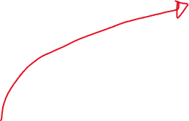
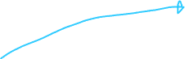


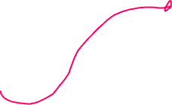

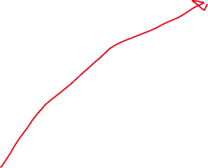
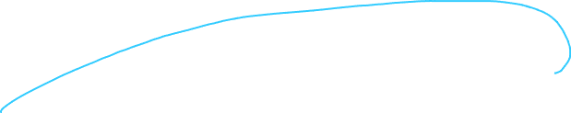
Draw
private final String vscode = "attribute vec3 vPosition;\n" + "attribute vec3 vColor;\n" + "varying vec3 color;\n" + "void main() {\n" + " gl_Position = vec4(vPosition, 1.0);\n" + " color = vColor;\n" + "}\n"; private final String fscode = "precision mediump float;\n" + "varying vec3 color;\n" + "void main() {\n" + " gl_FragColor = vec4(color, 1.0);\n" + "}\n";
public void draw() { GLES20.glUseProgram(program); GLES20.glBindBuffer(GLES20.GL_ARRAY_BUFFER, buffer); int pos = GLES20.glGetAttribLocation(program, "vPosition"); GLES20.glEnableVertexAttribArray(pos); GLES20.glVertexAttribPointer(pos, 3, GLES20.GL_FLOAT, false, 6 * 4, 0); pos = GLES20.glGetAttribLocation(program, "vColor"); GLES20.glEnableVertexAttribArray(pos); GLES20.glVertexAttribPointer(pos, 3, GLES20.GL_FLOAT, false, 6 * 4, 3 * 4); GLES20.glDrawArrays(GLES20.GL_TRIANGLES, 0, 3); GLES20.glDisableVertexAttribArray(pos); } }
0.0
1.0
0.0
1.0
0.0
0.0
-1.0
-1.0
0.0
0.0
1.0
0.0
1.0
-1.0
0.0
0.0
0.0
1.0
float[] vertex = { 0.0f, 1.0f, 0.0f, 1.0f, 0.0f, 0.0f, -1.0f, -1.0f, 0.0f, 0.0f, 1.0f, 0.0f, 1.0f, -1.0f, 0.0f, 0.0f, 0.0f, 1.0f };

Slide 11


다른 방식
float[] vertex = { 0.0f, 1.0f, 0.0f, -1.0f, -1.0f, 0.0f, 1.0f, -1.0f, 0.0f, }; float[] color = { 1.0f, 0.0f, 0.0f, 0.0f, 1.0f, 0.0f, 0.0f, 0.0f, 1.0f }; ByteBuffer bb = ByteBuffer.allocateDirect(vertex.length * 4); bb.order(ByteOrder.nativeOrder()); FloatBuffer vb = bb.asFloatBuffer(); vb.put(vertex); vb.position(0); ByteBuffer bb2 = ByteBuffer.allocateDirect(color.length * 4); bb2.order(ByteOrder.nativeOrder()); FloatBuffer vb2 = bb2.asFloatBuffer(); vb2.put(color); vb2.position(0); int[] buffers = new int[1]; GLES20.glGenBuffers(1, buffers, 0); buffer = buffers[0]; GLES20.glBindBuffer(GLES20.GL_ARRAY_BUFFER, buffer); GLES20.glBufferData(GLES20.GL_ARRAY_BUFFER, vertex.length * 4, vb, GLES20.GL_DYNAMIC_DRAW); int[] buffers2 = new int[1]; GLES20.glGenBuffers(1, buffers2, 0); buffer2 = buffers2[0]; GLES20.glBindBuffer(GLES20.GL_ARRAY_BUFFER, buffer2); GLES20.glBufferData(GLES20.GL_ARRAY_BUFFER, color.length * 4, vb2, GLES20.GL_DYNAMIC_DRAW);
public void draw() { GLES20.glUseProgram(program); GLES20.glBindBuffer(GLES20.GL_ARRAY_BUFFER, buffer); int pos = GLES20.glGetAttribLocation(program, "vPosition"); GLES20.glEnableVertexAttribArray(pos); GLES20.glVertexAttribPointer(pos, 3, GLES20.GL_FLOAT, false, 3 * 4, 0); GLES20.glBindBuffer(GLES20.GL_ARRAY_BUFFER, buffer2); pos = GLES20.glGetAttribLocation(program, "vColor"); GLES20.glEnableVertexAttribArray(pos); GLES20.glVertexAttribPointer(pos, 3, GLES20.GL_FLOAT, false, 3 * 4, 0); GLES20.glDrawArrays(GLES20.GL_TRIANGLES, 0, 3); GLES20.glDisableVertexAttribArray(pos); }

Slide 12
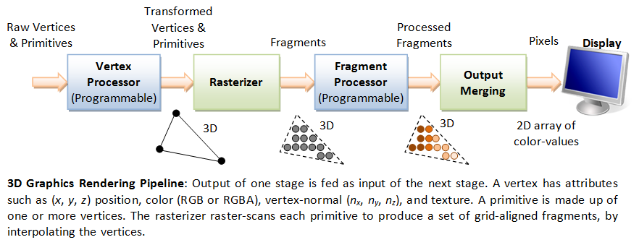









Shader 간략한 문법
private final String vscode = "attribute vec3 vPosition;\n" + "attribute vec3 vColor;\n" + "varying vec3 color;\n" + "void main() {\n" + " gl_Position = vec4(vPosition, 1.0);\n" + " color = vColor;\n" + "}\n"; private final String fscode = "precision mediump float;\n" + "varying vec3 color;\n" + "void main() {\n" + " gl_FragColor = vec4(color, 1.0);\n" + "}\n";

Slide 13
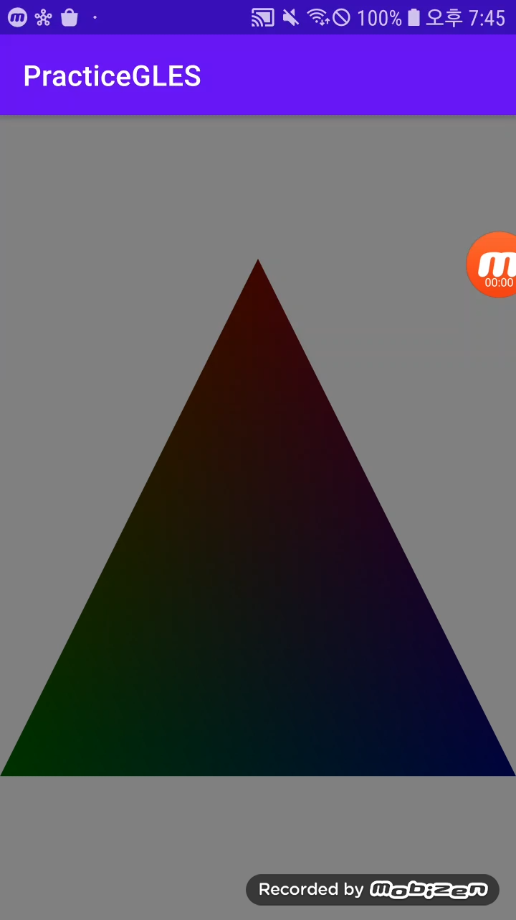
변화하는 삼각형

Slide 14

MainActivity.java
@Override public void onSurfaceChanged(GL10 gl, int width, int height) { gl.glViewport(0, 0, width, height); triangle.changeSize(width, height); } long lastTime = SystemClock.elapsedRealtime(); @Override public void onDrawFrame(GL10 gl) { GLES20.glClear(GLES20.GL_COLOR_BUFFER_BIT | GLES20.GL_DEPTH_BUFFER_BIT); long currentTime = SystemClock.elapsedRealtime(); float dt = (float)(currentTime - lastTime) / 1000.0f; lastTime = currentTime; triangle.draw(dt); }
public void changeSize(int width, int height) { this.width = width; this.height = height; }
변화하는것 표현하기 위해 dt
이쁜 삼각형 위해 현재 화면 크기 받아오기

Slide 15


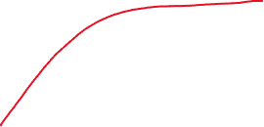

Shader
CPU에서 변수(정수, 소수, 행렬 등)
몇개 보내고 싶을 때 uniform 사용
private final String vscode = "attribute vec3 vPosition;\n" + "attribute vec3 vColor;\n" + "uniform mat4 aspectMX;\n" + "varying vec3 color;\n" + "void main() {\n" + " gl_Position = aspectMX * vec4(vPosition, 1.0);\n" + " color = vColor;\n" + "}\n"; private final String fscode = "precision mediump float;\n" + "varying vec3 color;\n" + "uniform float t;\n" + "void main() {\n" + " gl_FragColor = vec4(color * t, 1.0);\n" + "}\n";
pos = GLES20.glGetUniformLocation(program, "aspectMX"); GLES20.glUniformMatrix4fv(pos, 1, false, aspectMX, 0);
time += dt; pos = GLES20.glGetUniformLocation(program, "t"); GLES20.glUniform1f(pos, (float) (Math.cos((double) time) + 1.0) / 2.0f);

Slide 16
"gl_Position = aspectMX * vec4(vPosition, 1.0);\n"
(0, 1)
float aspect = (float) (width) / (float) (height); float[] aspectMX = { Math.min(1.0f / aspect, 1.0f), 0.0f, 0.0f, 0.0f, 0.0f, Math.min(aspect, 1.0f), 0.0f, 0.0f, 0.0f, 0.0f, 1.0f, 0.0f, 0.0f, 0.0f, 0.0f, 1.0f };
(0, 1)
(-1, 0)
(1, 0)
(-1, 0)
(1, 0)
(0, -1)
(0, -1)
화면의 비율이 1 : 1.7이면 y축이 1/1.7배로 수축한 좌표계로 변환

Slide 17
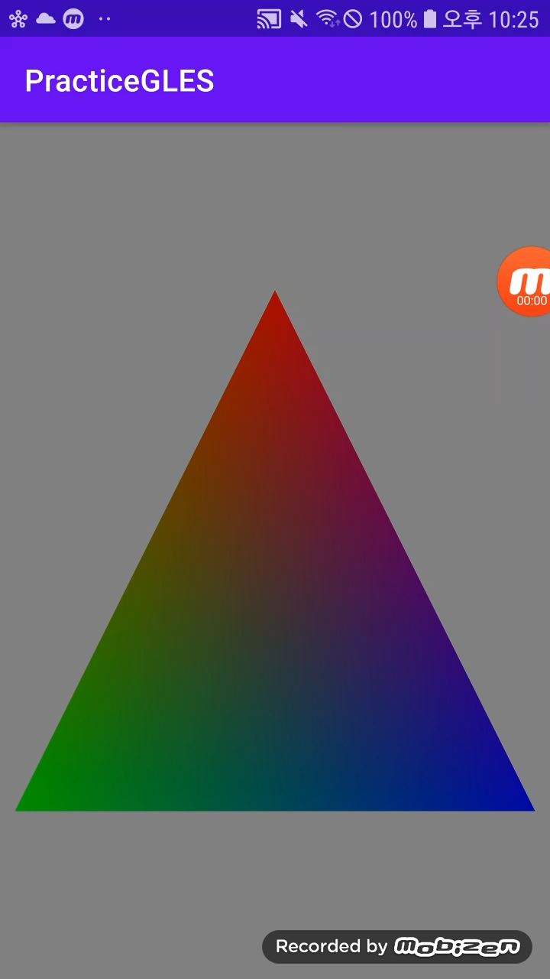
연습용 문제 1
OnTouchListener 사용법 :
@SuppressLint("ClickableViewAccessibility") @Override protected void onCreate(Bundle savedInstanceState) { super.onCreate(savedInstanceState); setContentView(R.layout.activity_main); glView = (GLSurfaceView) findViewById(R.id.surfaceview); glView.setPreserveEGLContextOnPause(true); glView.setEGLContextClientVersion(2); glView.setEGLConfigChooser(8, 8, 8, 8, 16, 0); glView.setRenderer(this); glView.setOnTouchListener(new View.OnTouchListener(){ @Override public boolean onTouch(View v, MotionEvent event) { triangle.isChangingSize = !triangle.isChangingSize; return false; } }); }
힌트 – aspectMX와 cos함수 활용
터치 반응만들기
커졌다 작아졌다 하도록 만들기

Slide 18
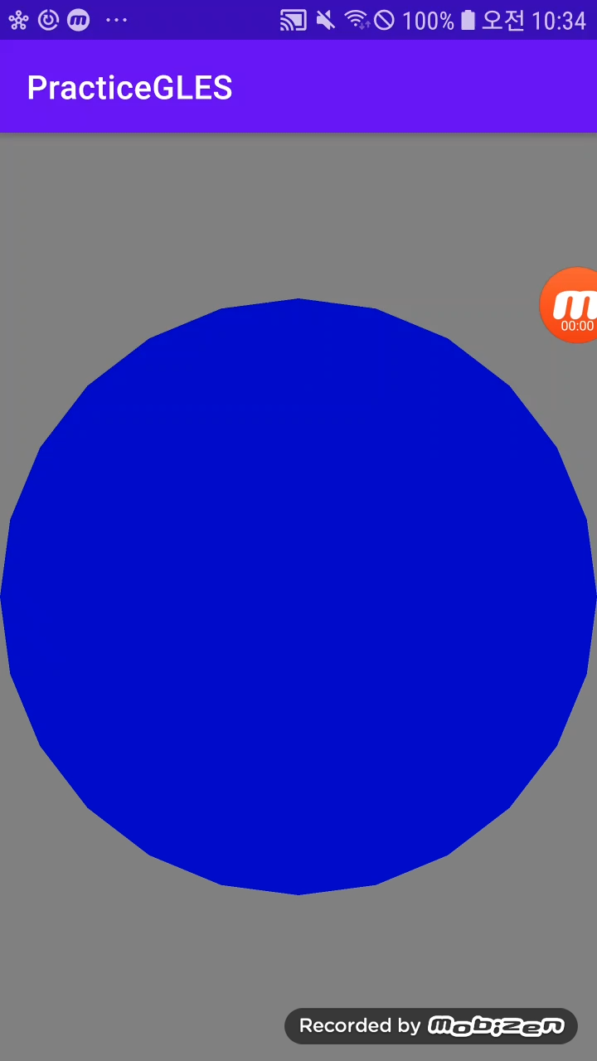
연습용 문제2
힌트 – 원은 중심각이 2pi / 24인 삼각형 24개로 근사 가능
final int length = 24 * 6 * 3; ByteBuffer bb = ByteBuffer.allocateDirect(length * 4); bb.order(ByteOrder.nativeOrder()); vb = bb.asFloatBuffer(); for (int i = 0; i < 24; i++) { double theta1 = (Math.PI / 12 * i); double theta2 = (Math.PI / 12 * (i + 1)); float[] vertex = { ? }; vb.put(vertex); } vb.position(0);
원 만들기

